Slide 1
How to install and run neuralNet_cfTiberius.xlsm
In Excel

Slide 2
Download the macro-enabled workbook
https://www.forecastMethods.com , click on “neuralNet_cfTiberius.xlsm”

Slide 3
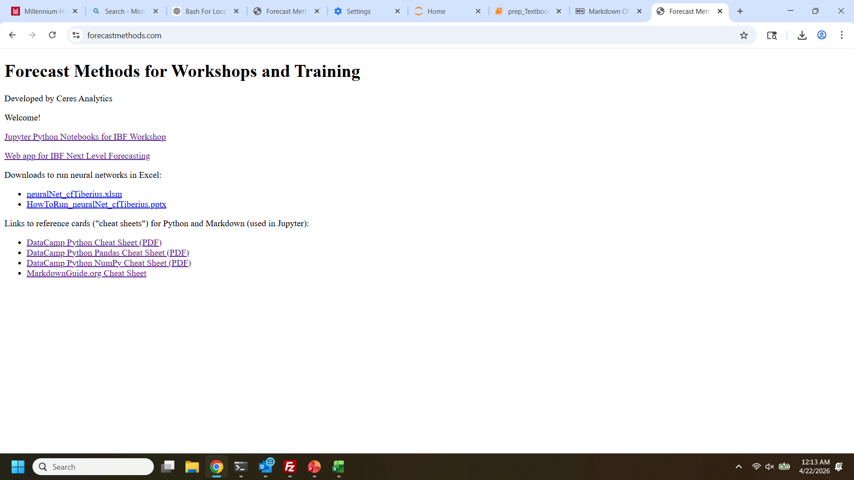

Slide 4
Manage add-ins
AnalysisToolPak
AnalysisToolPak

Slide 5
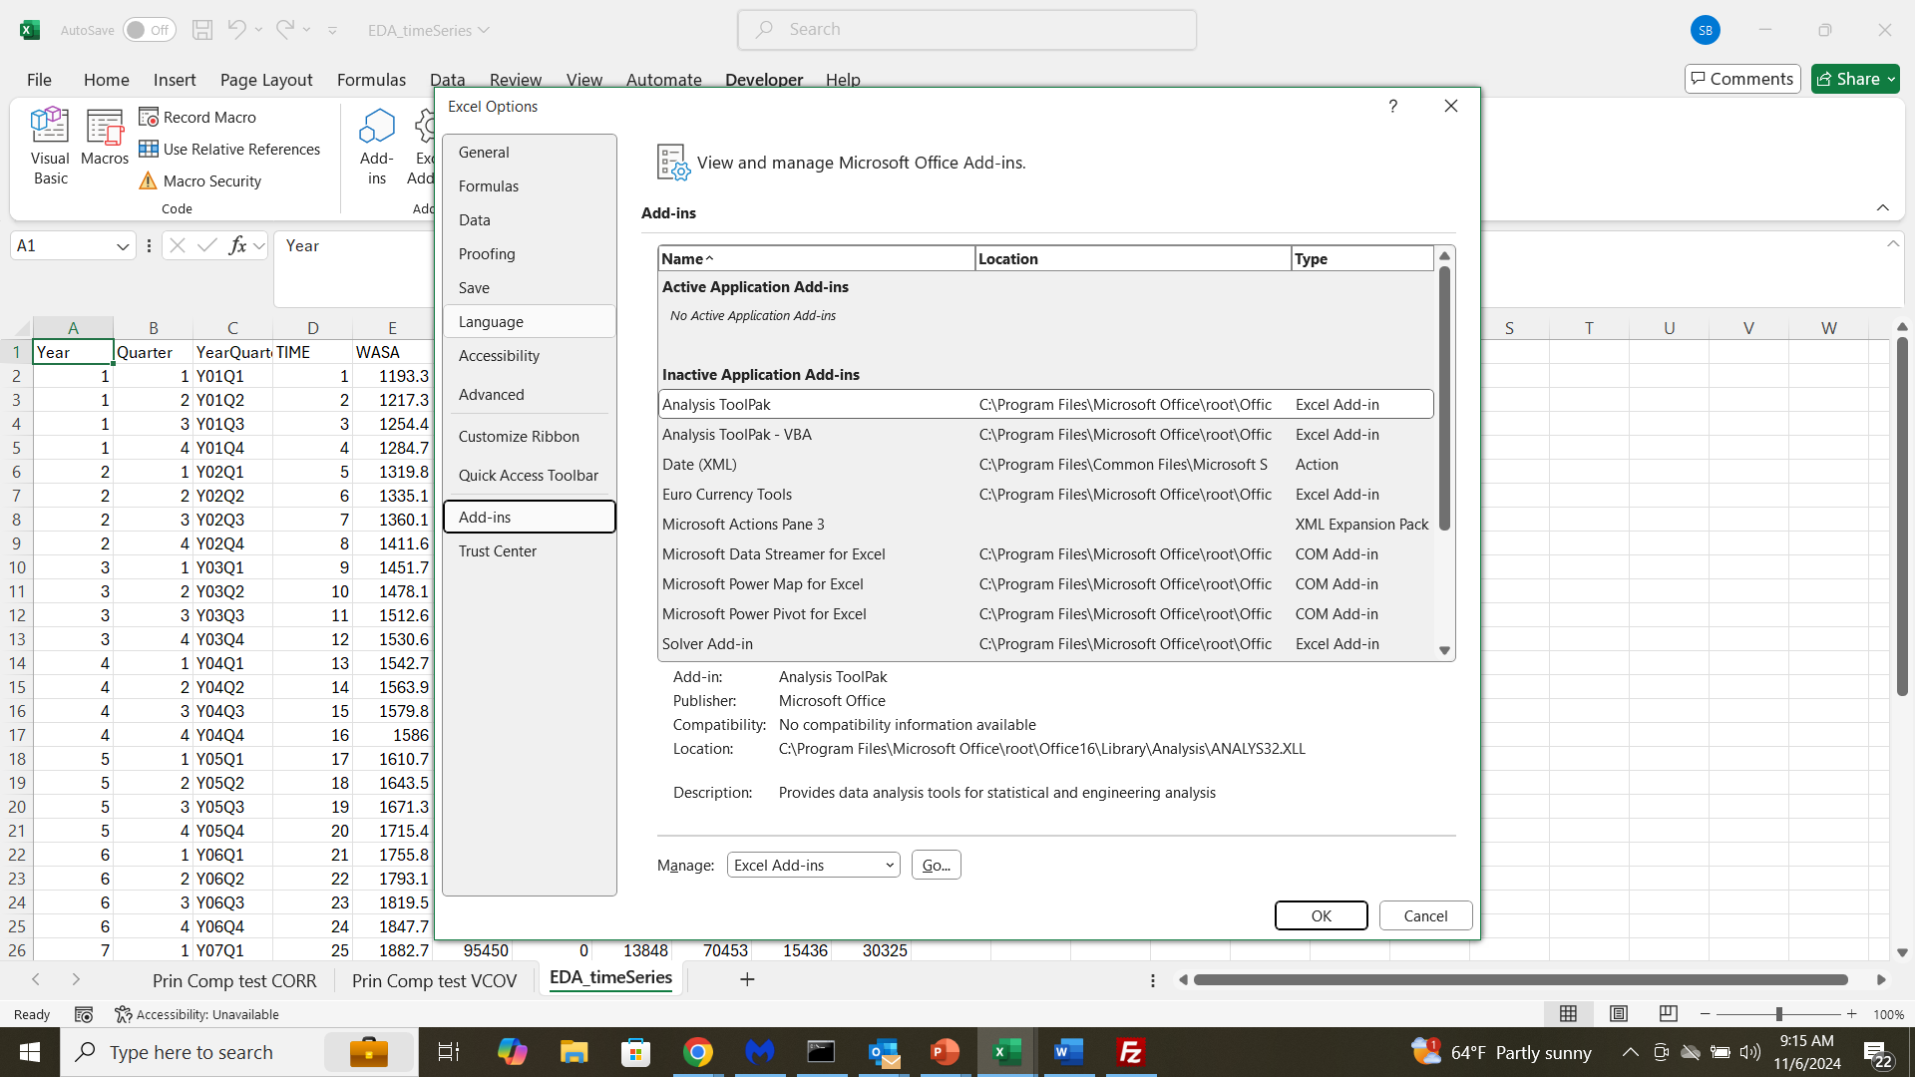
(1) From File/Options (bottom choice)
(2)
(3)

Slide 6
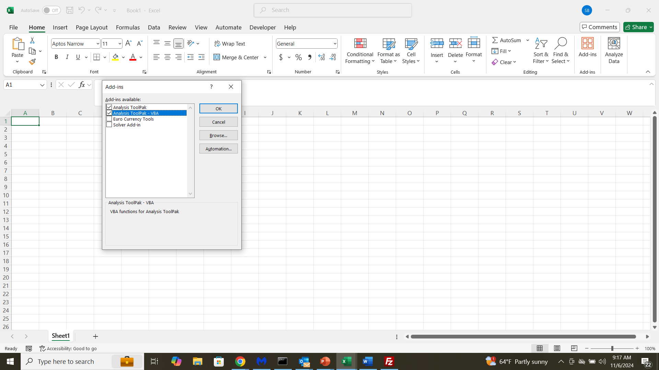

Slide 7
Enable Macros
In Windows Explorer, neuralNet_cfTiberius.xlsm in your saved location

Slide 8
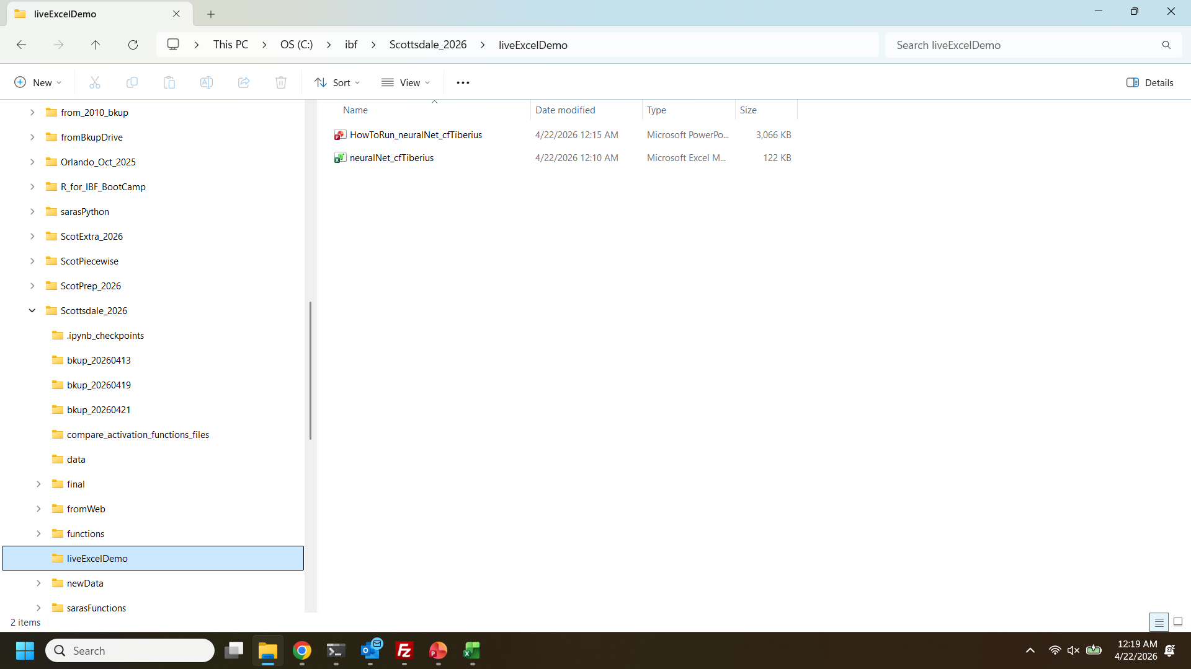
1. Windows Explorer
2. Navigate to folder
3. RIGHT CLICK on NeuralNet_cfTiberius.xlsx

Slide 9
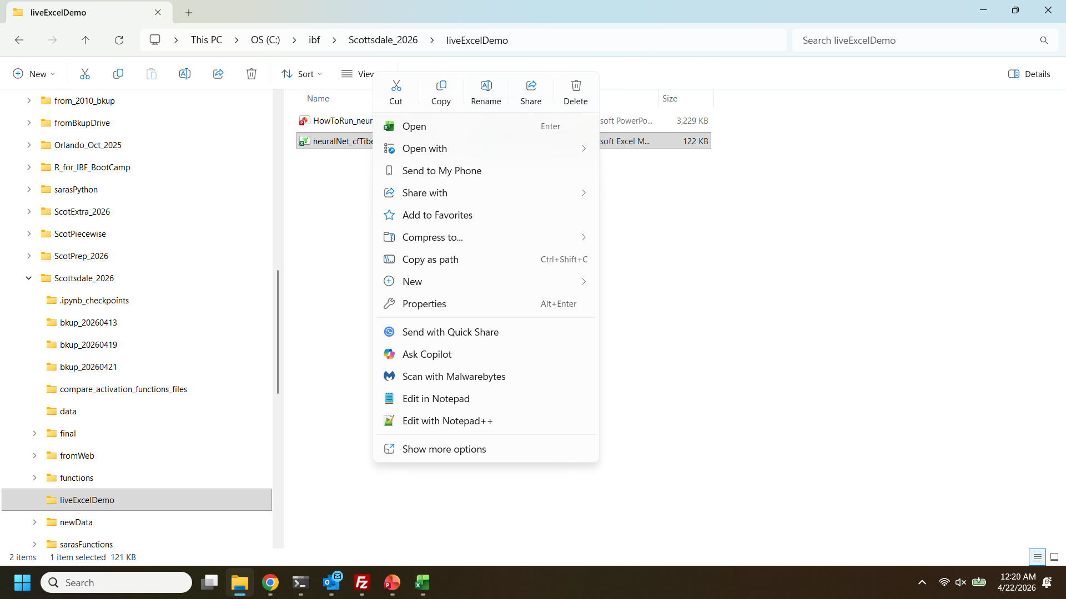
Choose properties

Slide 10
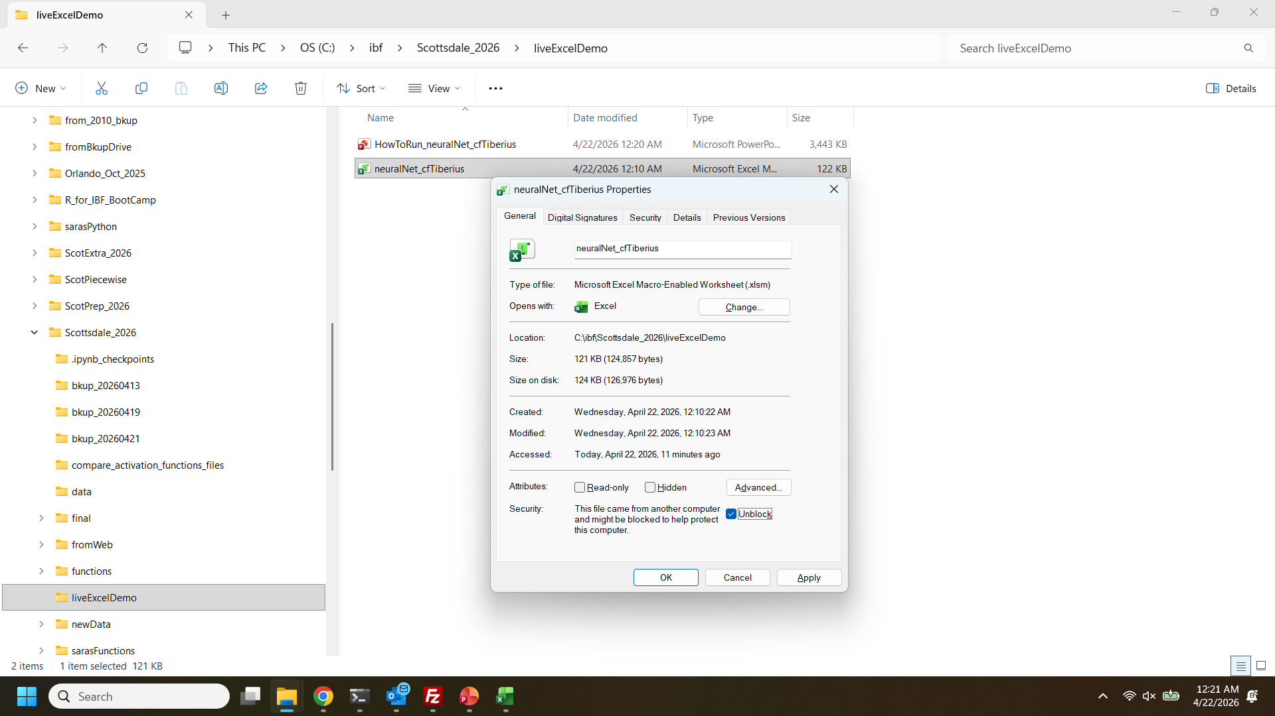
1) Check Unblock
2) Click OK

Slide 11
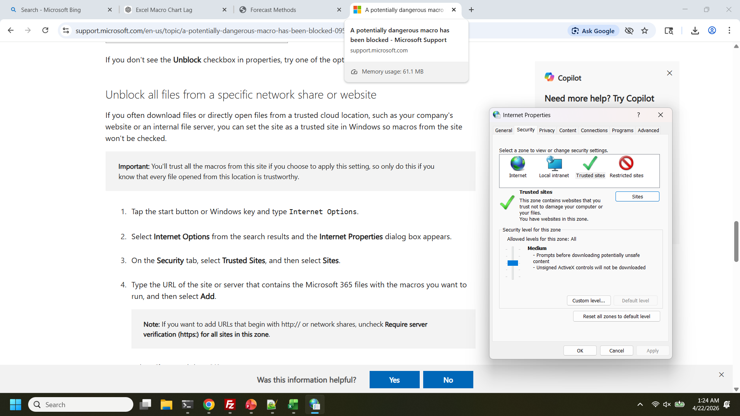
IF THAT DIDN’T WORK…
https://forecastmethods.com

Slide 12
Open neuralNet_cfTiberius.xlsm
from your saved location

Slide 13
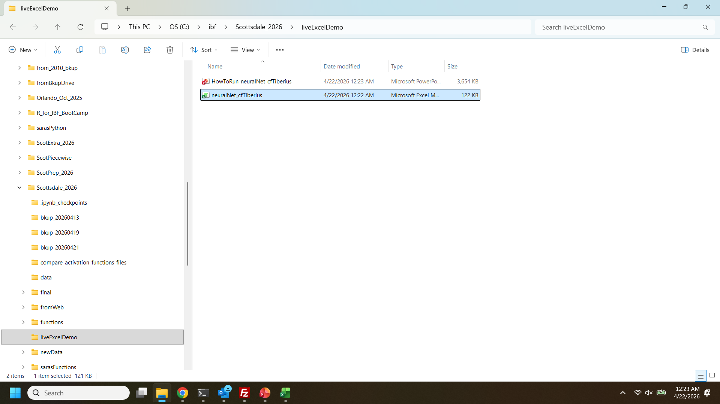
Double-click to open

Slide 14
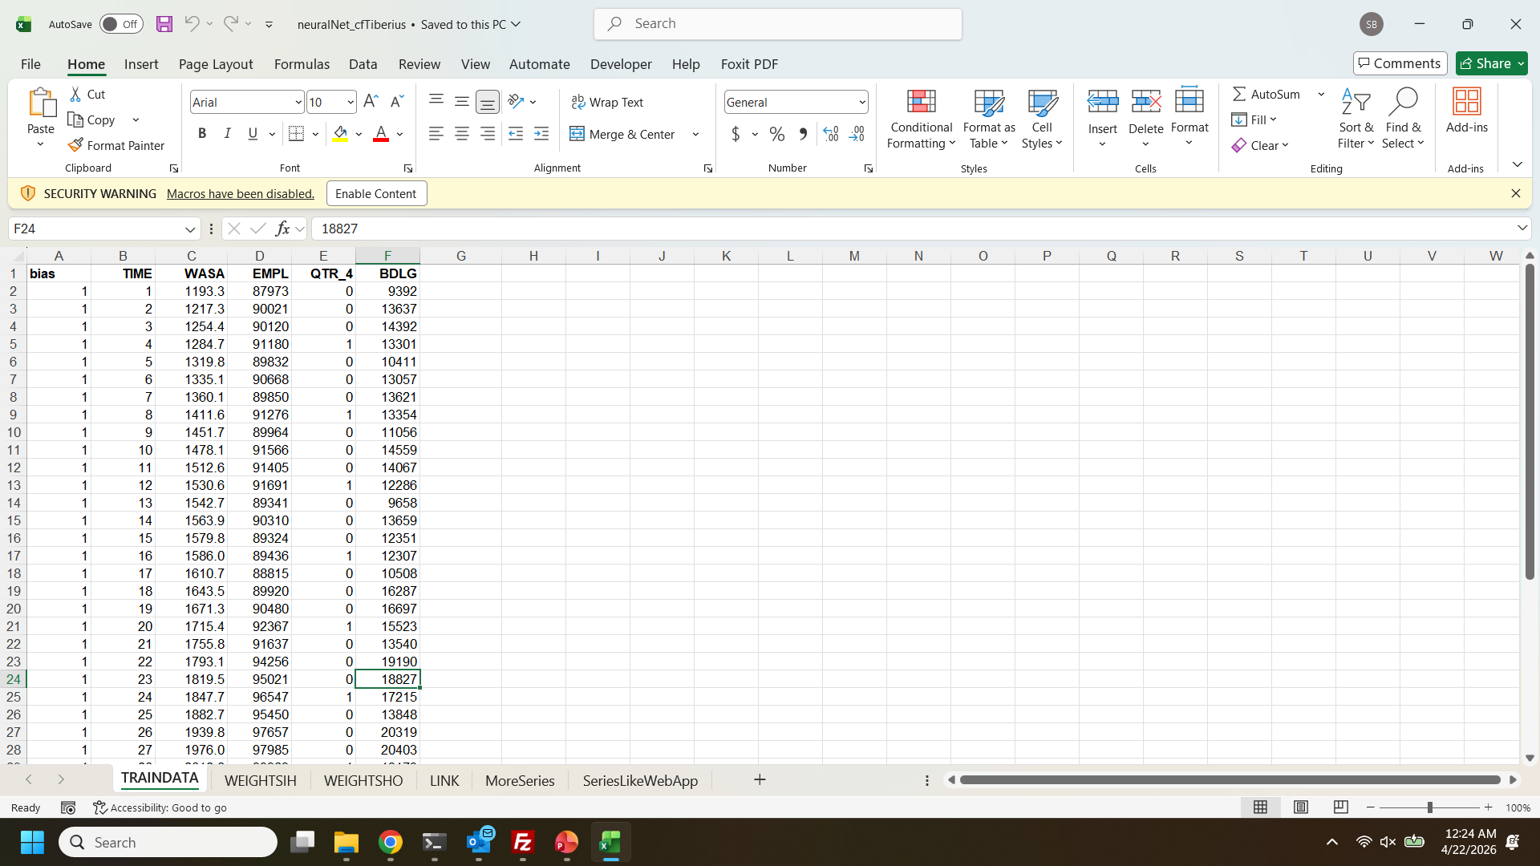
Click “Enable Content”

Slide 15
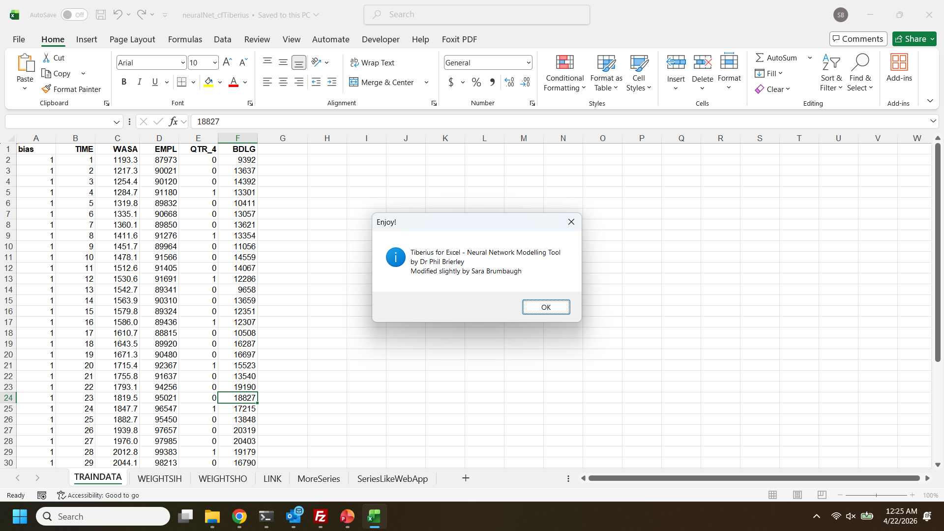
Click “OK”

Slide 16
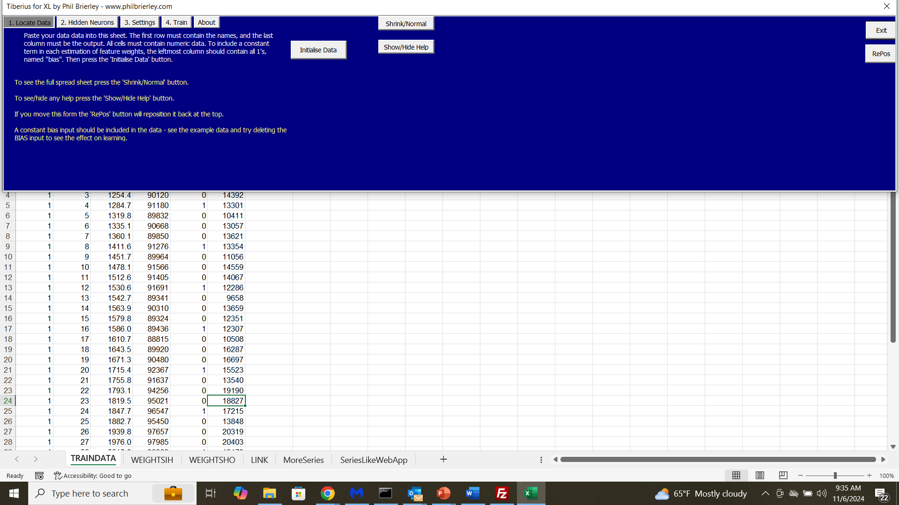

Slide 17
NOTE: You can run Tiberius with your own data:
Simply paste it into the TRAINDATA sheet from cell B1
Make sure the dependent variable (what you want to predict) is in the rightmost column
Edit column A (“bias”) to have as many rows as the data you pasted in
Then click “Initialise Data” to read them in

